Slide 1
Predicting UK Car Accidents Severity

Slide 2
Predicting UK Car Accidents Severity
Road traffic injuries are estimated to be the eighth leading cause of death globally for all age groups and the leading cause of death for children and young people 5–29 years of age.
More people now die in road traffic crashes than from HIV/AIDS.
Traffic safety not only an engineering problem, but also a political, economic and public health issue of major significance.

Slide 3
Data acquisition and cleaning
Data pre-processing：
1
A dataset of UK traffic data from 2005 and 2015 from Kaggle was used. It is amassed by the UK Government recording over 1.7 million accidents.
2
In total there are 1780653 rows and 31 columns in the data.
3
Null values and unknown are removed.
4
Cleaned data contains 1760539 rows and 25 columns

Slide 4
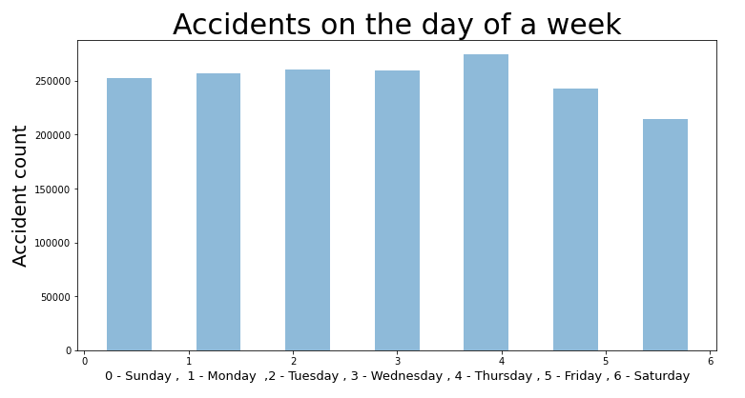
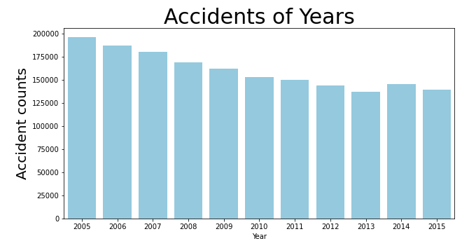
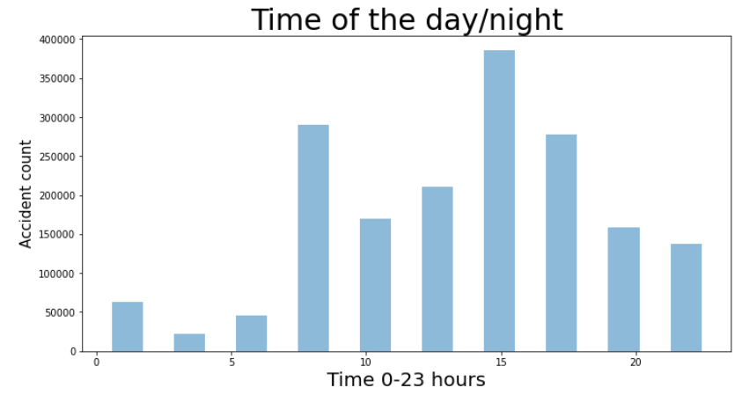
Exploratory Data Analysis
The total number of accidents decreased from 2005 to 2015.
As we can see that Thursday has the highest amount of accidents in this dataset from 2005 to 2015 and Saturday has the lowest amount. But the variation is not large.
We found out that the most of accidents happened around after noon.

Slide 5
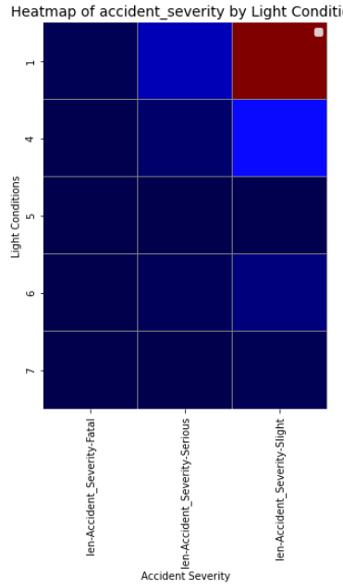
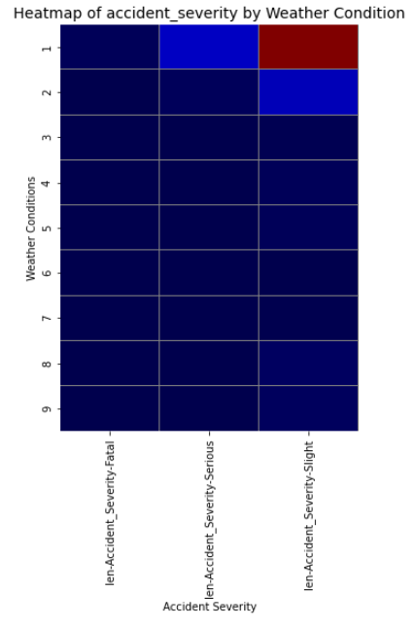
Exploratory Data Analysis
Weather conditions and Light conditions do not seem to have impact on Accident Severity.

Slide 6
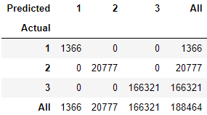
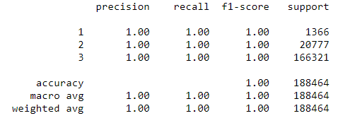
Machine Learning
Logistic regression was used to train the data.
The features in ‘Vehicles’ dataset were added into the model. The joined data is cleaned up again eliminating Nan and unknown values for training.
Then object features were dropped and ‘Vehicle_Type' was one hot encoded. The dataframe is then standardized and fit in to the model using 80/20 split. We will use f1-score to evaluate the model.

Slide 7
Discussion and Conclusion
The selected dataset can accurately predict the severity of accidents in the UK during 2005-2015.
However, which of the used features are more important in predicting the severity? This question could be further studied with the probability of each features. Furthermore, the ultimate study question would be – how accidents could be prevented?
This study would need a lot of data of all kind of traffic information.

